Slide 1

SALES DASHBOARD
BY VIDYASHRI MANE

Slide 2
Sales Dashboard
What is sales analysis?
ANS: Sales analysis is using data to evaluate sales team performance. It provides valuable insights about the top performing and underperforming products/services, selling and market opportunities, and includes sales forecasting.

Slide 3
Over view of the project
Import Data to Power BI
Edit Data in Power Query Editor
Create Columns & Measures
Create Visuals
Format Dashboard Background
Format Visuals

Slide 4
HERE WE USED TWO DATA SET:
INPUT DATA
MASTER DATA
INPUT DATA: It consist of 6 column and 527 rows.
Columns like:
DATE
PRODUCT ID
QUANTITY
SALE TYPE
PAYMENT MODE
DISCOUNT %

Slide 5
MASTER DATA: It consist of 6 column and 45 rows.
PRODUCT ID
PRODUCT
CATEGORY
UOM
BUYING PRIZE
SELLING PRICE

Slide 6
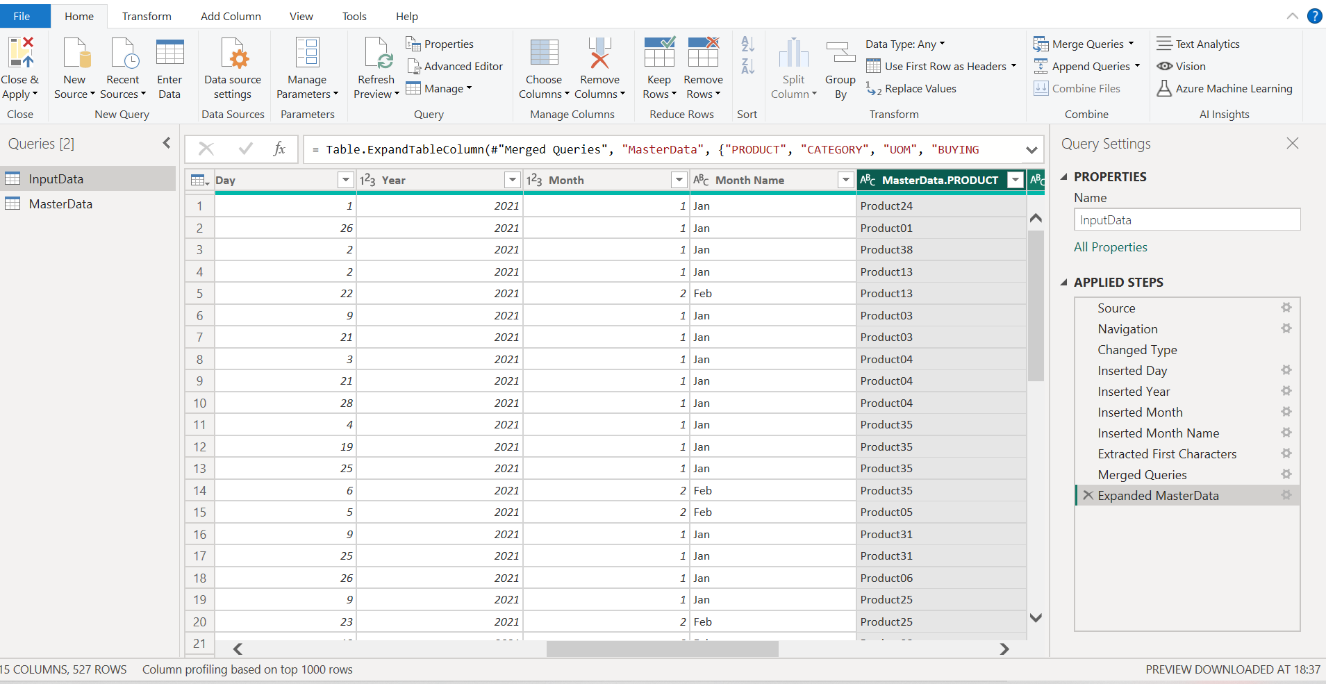
Data cleaning process

Slide 7
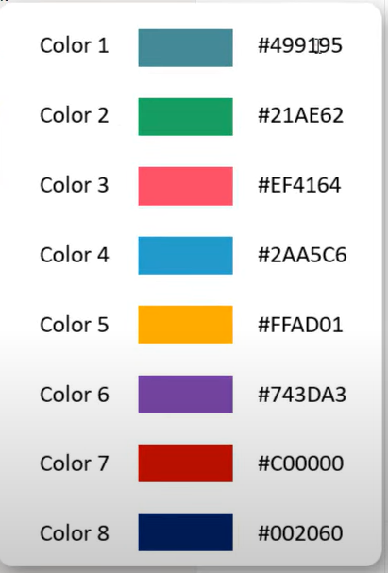
Color used for dashboard

Slide 8
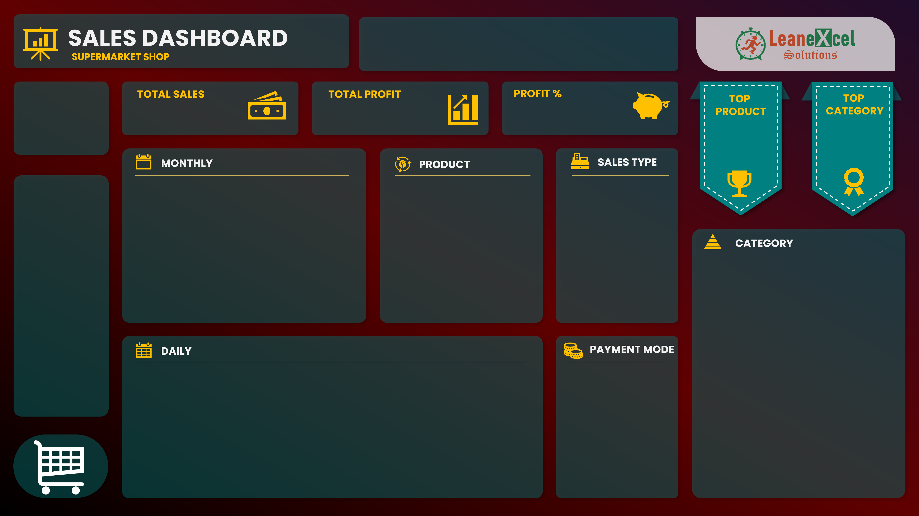
Background image used

Slide 9
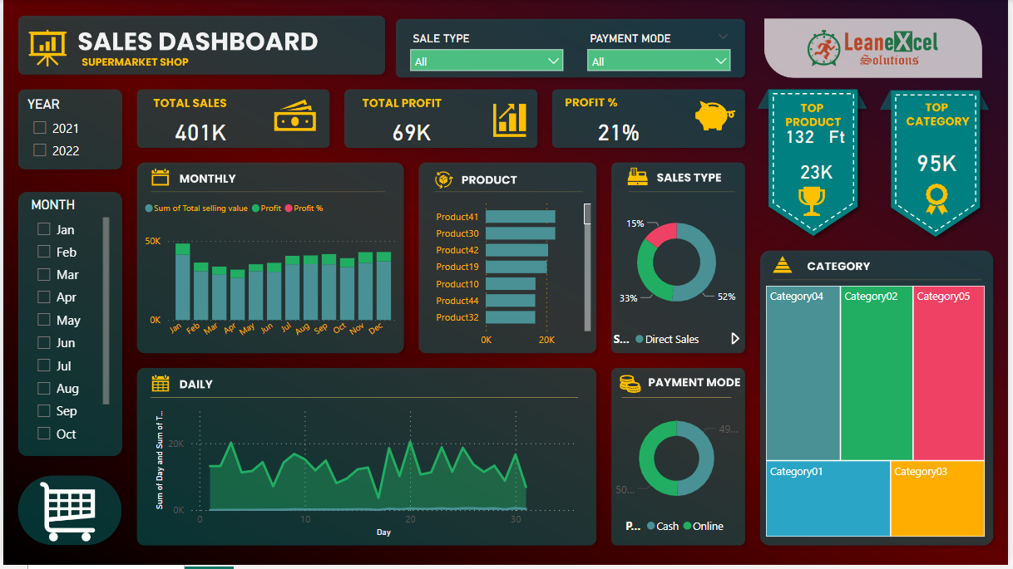
Final view of the sale dashboard

Slide 10

FROM VIDYASHRI MANE

